Slide 1



Engineering center
«High-temperature composite materials"
STATE EDUCATIONAL INSTITUTION OF HIGHER EDUCATION MOSCOW REGION
UNIVERSITY OF TECHNOLOGY
created by «MGOTU» in association with JSC «Kompozit»
Korolyov, 1 Stadionnaya street
www.kompozit-ut.ru

Slide 2

High-temperature composite materials
Density, g/см³
various steel grades
- traditional carbon and glass fiber plastics
titanium
aluminium
*
High-temperature composite materials
20
200
1000
1500
Temperature, °С
New formulations of polymeric composite material
Composite materials with carbon and ceramic matrixes
*
www.kompozit-ut.ru

Slide 3
Engineering center
«High-temperature composite materials»
Basic department “Quality management and research in the field of new materials and technologies”
Head of the Department Doctor of Sciences
A.N. Timofeev
Laboratory of new ways of forming reinforcing frame for composite materials
Laboratory of heterogeneous synthesis of refractory materials
Head of laboratory
Candidate of Engineering Sciences I.A. Timofeev
Head of laboratory Doctor of Sciences
A.V. Chesnokov
Laboratory of CAD/CAM/CAE systems
Laboratory of Automated Equipment
Children's Technopark "Quantorium"

Slide 4

Development of technology of chemical deposition from the gas phase by University
2020
HfC_{CVI}
2020
2019
B₄C_{CVI}, SiB_{CVI}
2019
2018
SiC_{CVD}
2018
HfC_{CVD}
BN_{CVI}
2017
2017
2016
BN_{CVD}
2016
2015
2015
BN B4C HfC SiC
www.kompozit-ut.ru

Slide 5
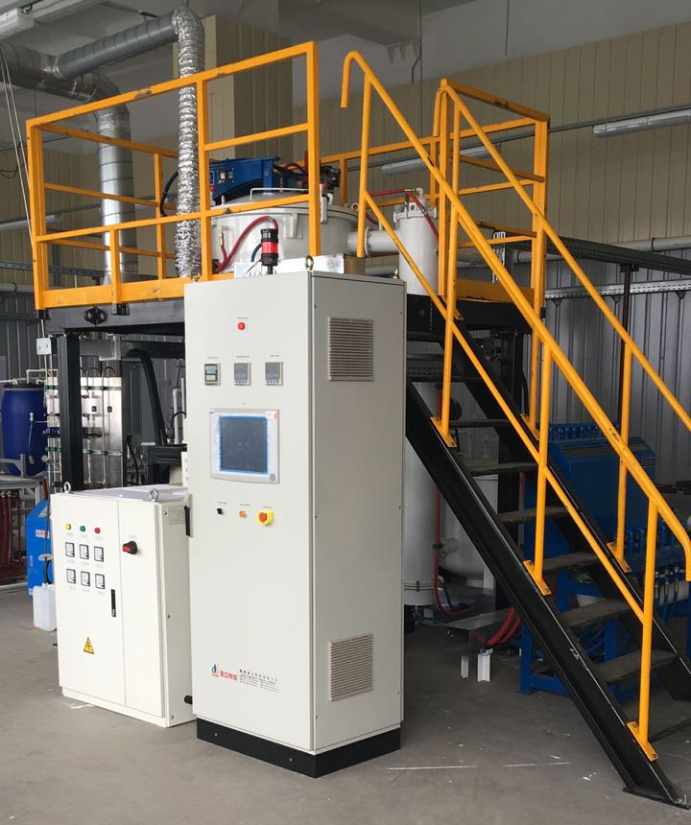
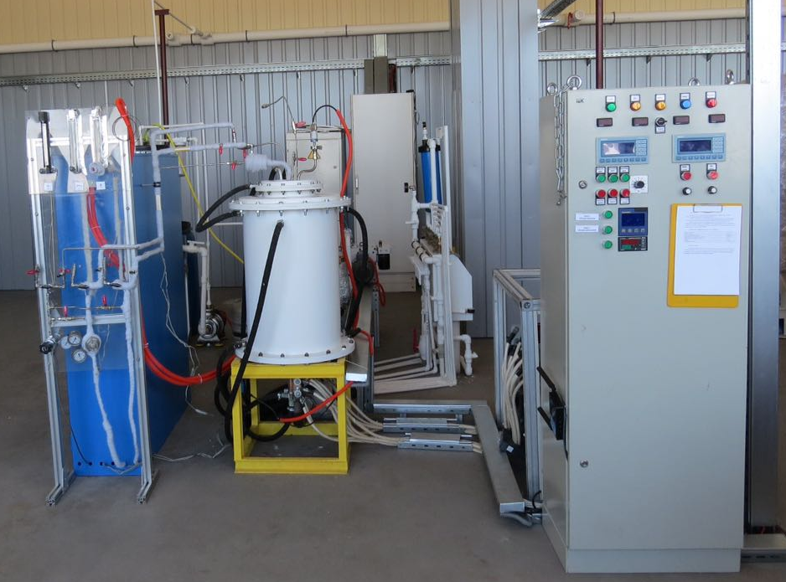
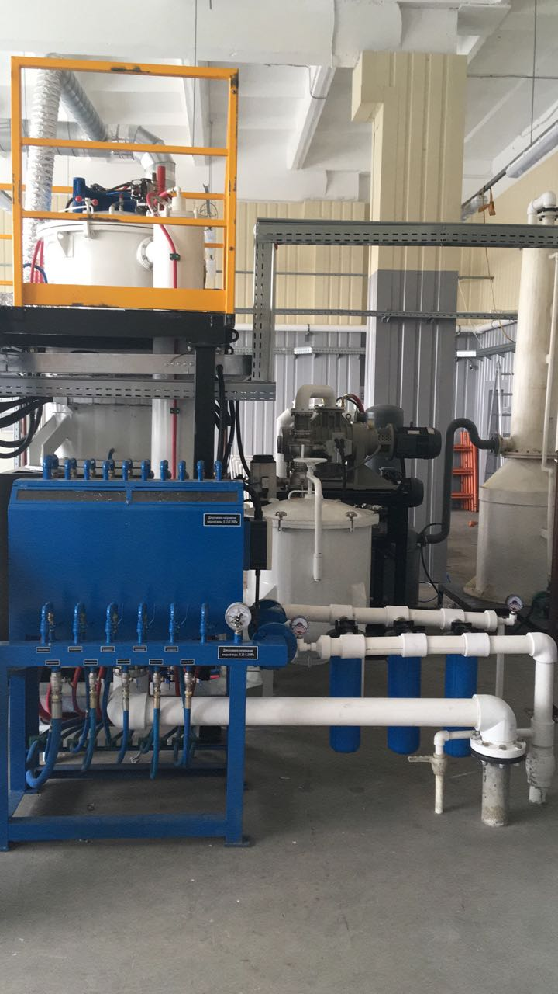
Gas-phase deposition plants
The pyrolytic boron nitride precipitation plant
Silicon carbide deposition plant
www.kompozit-ut.ru

Slide 6
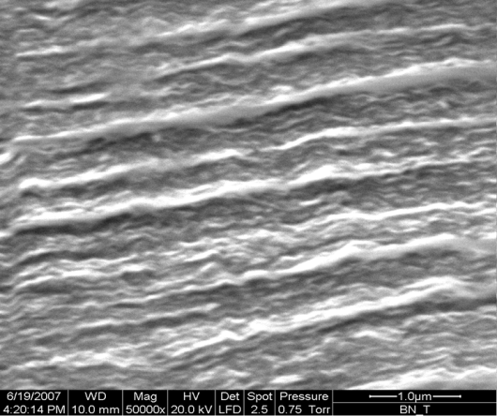
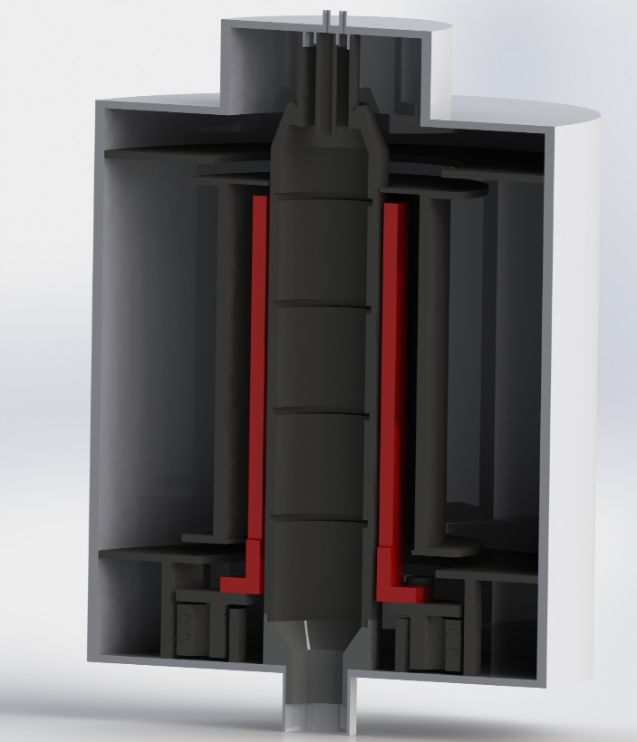
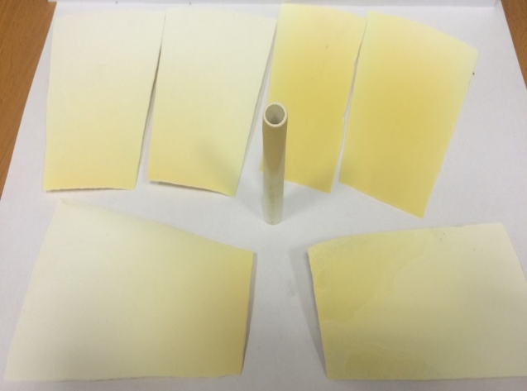
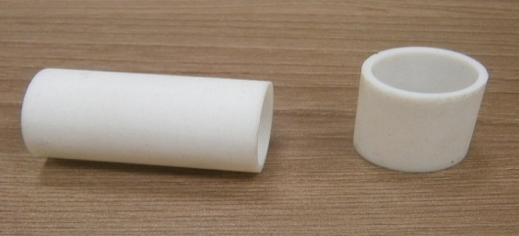
CVD technology of obtaining pyrolytic BN for the electronics industry
The flow reactor isothermal dimensions of the working area
D100 mm H300 mm
Option | Result
Crystal lattice | hexagonal
Density, g/cub.sm. | 1,97-1,99
Fraction of impurities, % at. | 0,01
Micrograph of a slice of a sample
Appearance of products

Slide 7
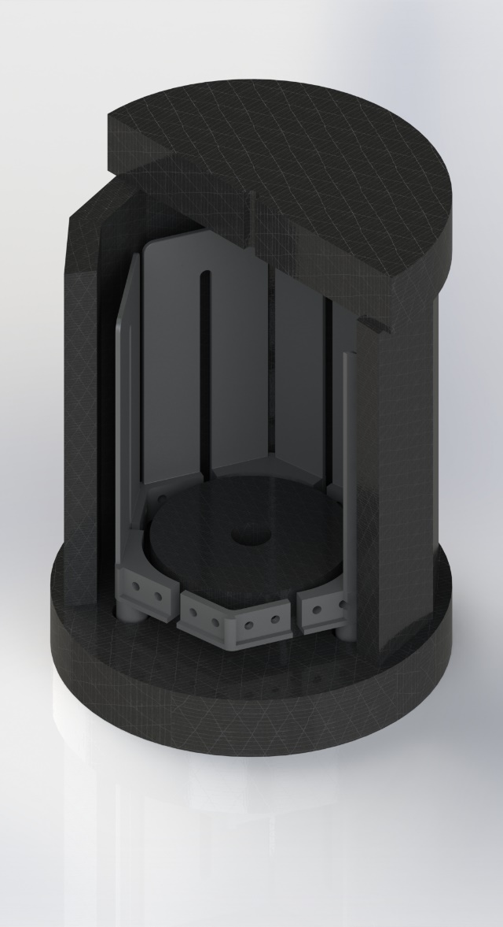
CVD technology of obtaining pyrolytic SiC for electronic industry
CH₃SiCl₃+CH₄ →SiC+4HCl
Products CVD-SiC
D100…380 мм; thickness 3,5…6,5 mm.
Density is more 3,19 g/cub.sm. The porosity is less 0,1 %.
R < 1 Ω×sm
Notes:
Used In:
Chemical seals and bearings
Equipment components
Semiconductor wafer-handling and chamber components
Optical components
Automotive applications
Wear components
Information storage media
Advantages:
Excellent resistance to wear and abrasion
Excellent resistance to corrosion, oxidation and erosion
Outstanding performance at high temperatures (up to 1700° C)
Superior flatness
Polishable to < 3 Å RMS

Slide 8
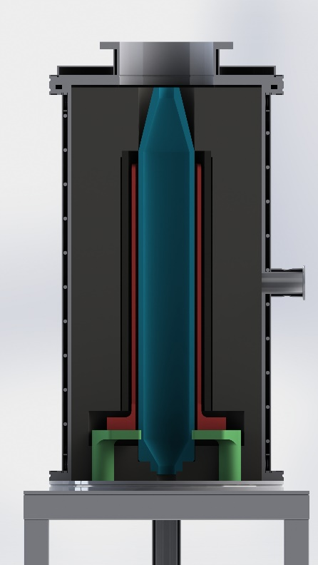
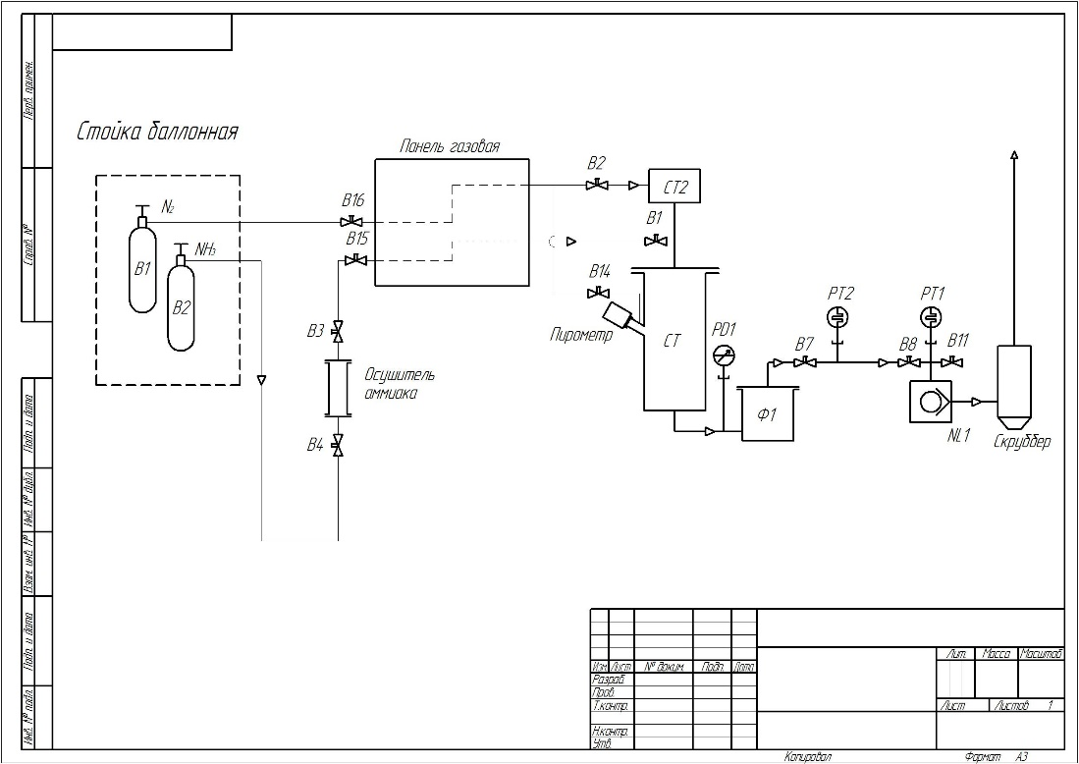
CVD technology of obtaining pyrolytic HfC
HfCl₄+CH₄ →HfC+4HCl
The size of the chemical reactor D80 H 350 mm.
Continuous monitoring of the mass of HfCl4 in the process of evaporation.
Notes:
Второе направление развиваемое на сегодняшний день в МГОТУ это CVD технология получения карбида гафния из тетрахлорида гафния и метана

Slide 9
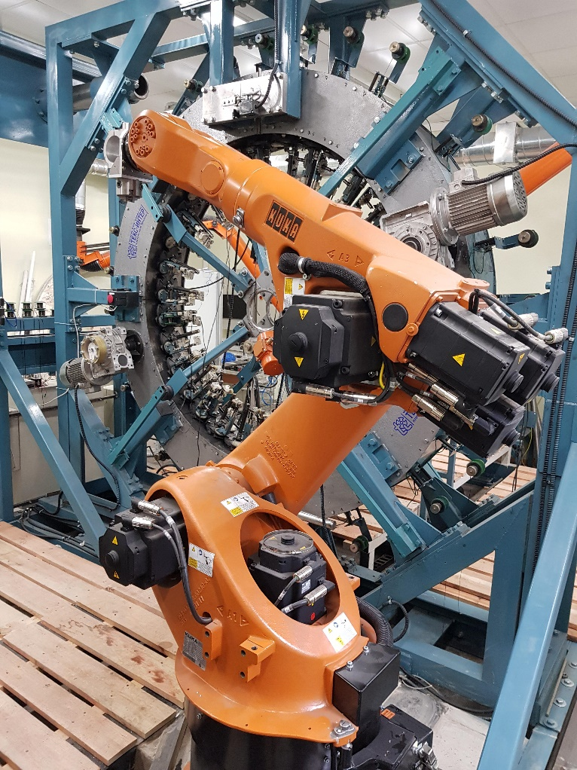
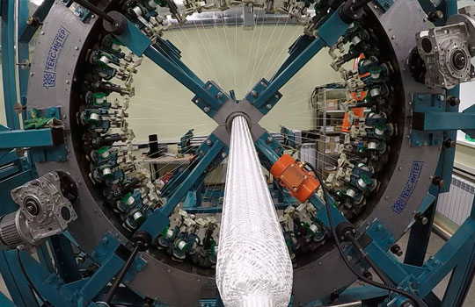
Braiding machine РП64-1-130
Braiding technologies
Contour weaving by Russian carbon high-strength and high-modulus yarns .
Contouring weaving on two and three axial (with skeletal reinforcement) schemes.
Contouring weaving products with a straight and curved axis.
Contouring weaving products with a closed axis .
Application of an interlayer layer with a continuous surface hiding power up to 200 mm in diameter.
Application of an interlayer layer to larger diameters with the formation of a network structure.
Contour weaving of products of unlimited length.
KUKA robot
kompozit-ut.ru

Slide 10


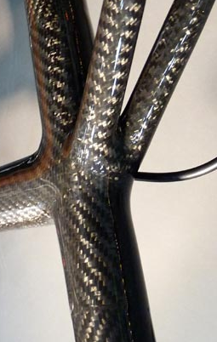
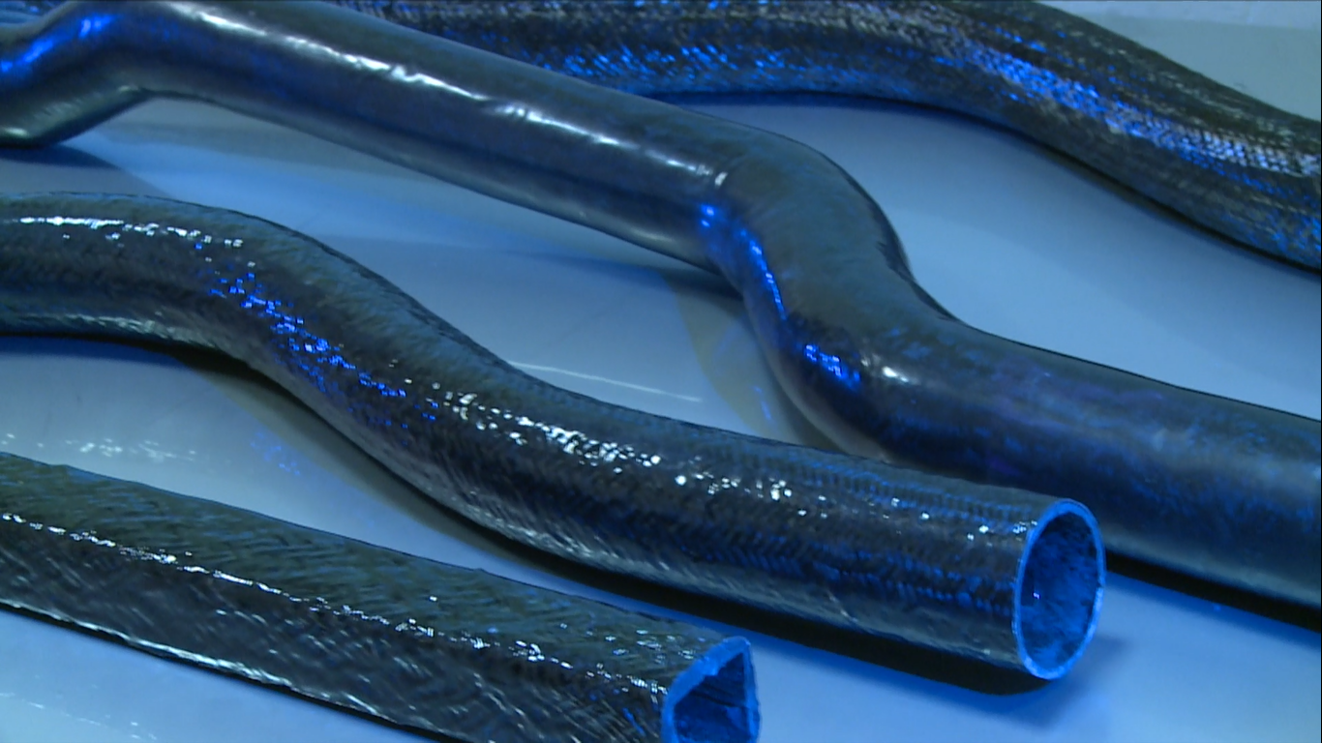
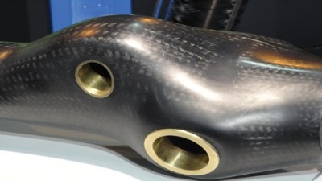
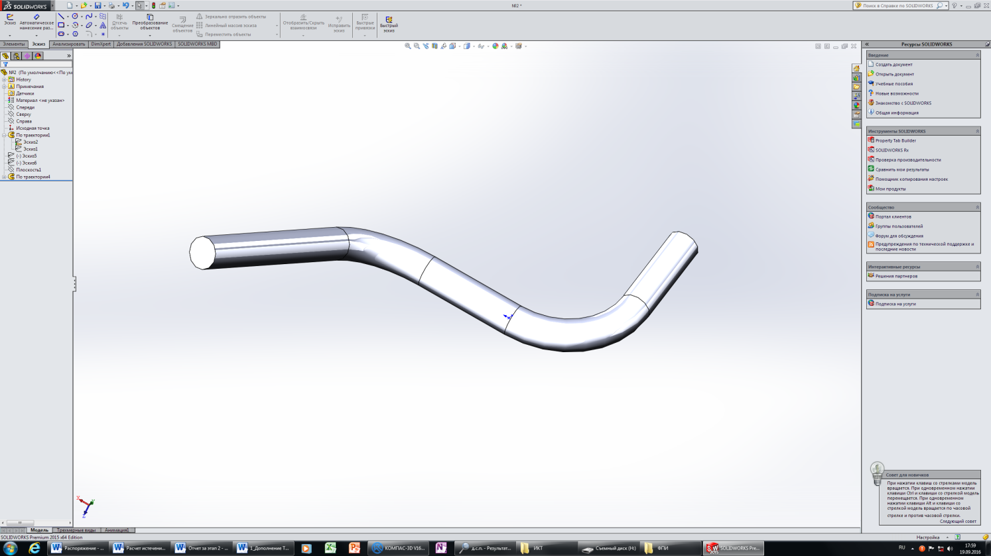
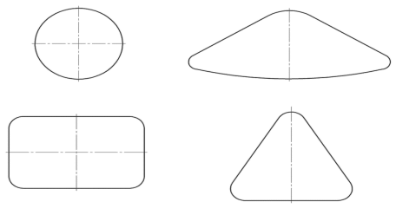
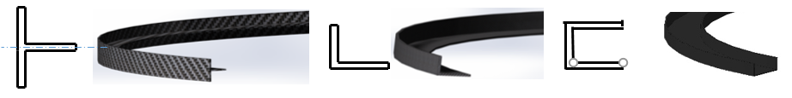
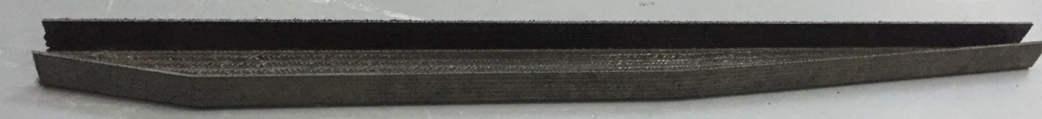
Braiding technologies
Technology for the production of complex profile composite preforms
Possible type of preforms
Possible cross-section of the frames:
Taleplerine frames
www.kompozit-ut.ru

Slide 11
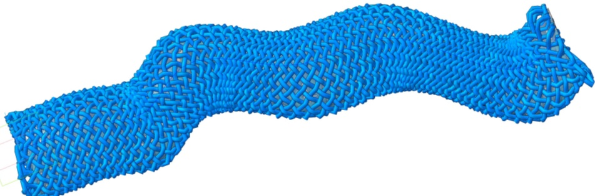
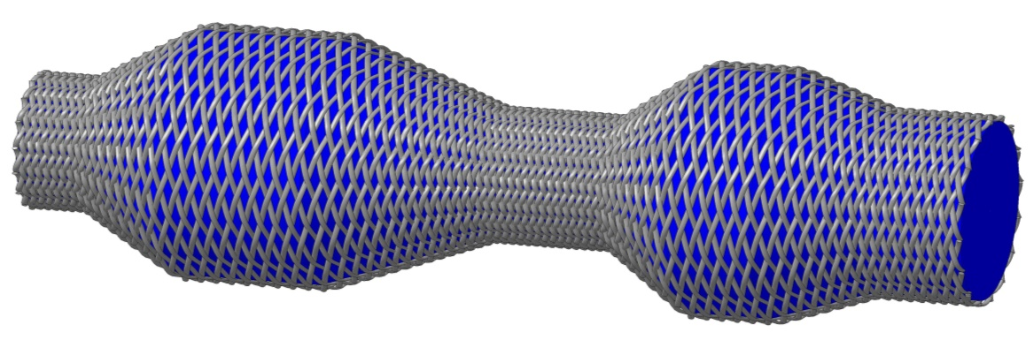
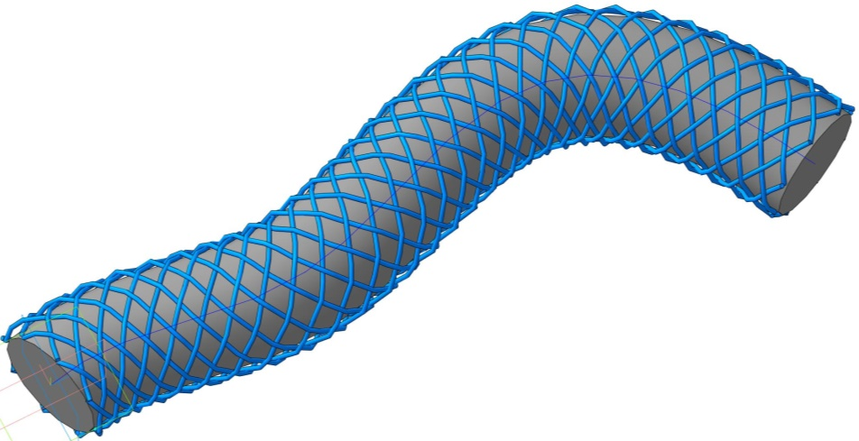
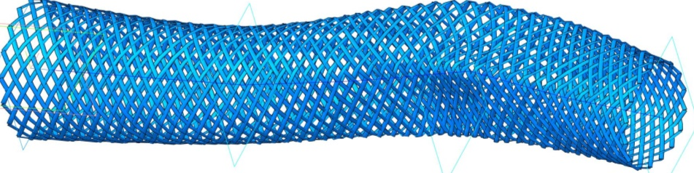
Software for modeling and controlling the process of braiding
The software allows:
to obtain a three-dimensional model of interlacing of bundles for analysis of the obtained structure and modeling of the strength characteristics of the product;
on the basis of the product model, develop control programs for the braiding machine with the required requirements for the method of laying the bundle-a constant reinforcement angle or a constant surface density of the bundles.
kompozit-ut.ru

Slide 12

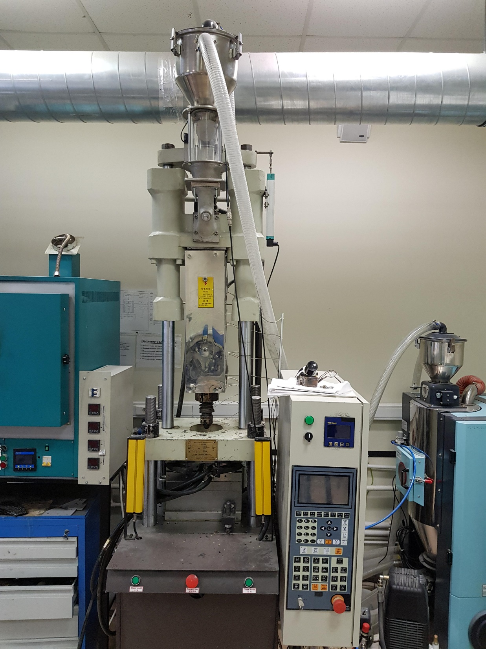
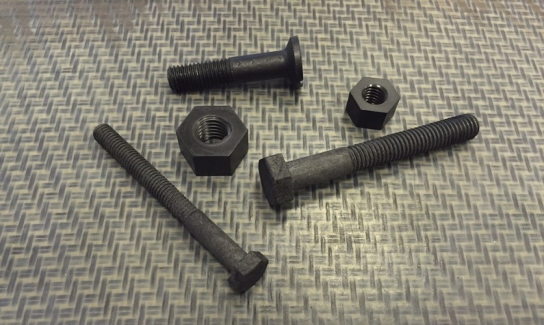
High temperature carbon fiber on the basis of polyetheretherketone
Injection molding machine specialized to work with reinforced PEEK
Fasteners and sheet prefabricated from reinforced Peace
polyetheretherketone
CARBON FIBER
Milled fiber – injection molding.Thread, harness – winding, weaving, braiding.Ribbon, fabric – layout.
High temperature (Process Temperature up to 350°С) carbonplastic
Continuosly carbon reinforced PEEK have the similar (not lower) properties like regular plastics with thermoreactive matrix.
Carbon fiber reinforced PEEK on the strength of 1.5-4 times greater than aluminum alloys, and 2-3 times higher than engineering plastics at temperatures over 200°C .
A price comparable to aluminum parts at mass production.
Density reinforced PEEK 2 times lower aluminum.
Temperature operation completely replaces the aluminum.
kompozit-ut.ru

Slide 13
Possible areas for cooperation
CVD BN for the electronics industry
CVD SiC for electronic industry
3. Siliconized details including
4. Thermoplastic Polymers fittings, includes PEEK fittings
5. Curved lines and frames made of composite materials

